Slide 1
Computer Organization
COIS 2300H
Brian Srivastava

Slide 2
Close to the Metal
This course is very much the hardware software boundary
Hardware components provide software instructions (e.g. add, matrix multiply, divide etc.)
High level languages get translated into low level languages to be run, but how does that happen?
Can an instruction set be efficient (however you want to define it)?
Notes:
Stealing a slogan from AMD/ATI

Slide 3
Measuring performance
In 2020H you are worried about questions like ‘what is the most efficient way to search N things’
In 2300H you are worried about questions like ‘what is the most efficient way to store a number in memory’ or how to multiply two integers/floating point/etc. numbers together

Slide 4
Simple math
c=a*b, c=a+b, c=a/b (for example).
Will ints and floats have different speeds?
What about 8/16/32/64 bits length?
If, at 1Hz (or realistically 1GHz) processor A can do 300 million c=a*b a second, and Processor B (say, a never version of A) can do 330 million what does that mean?

Slide 5
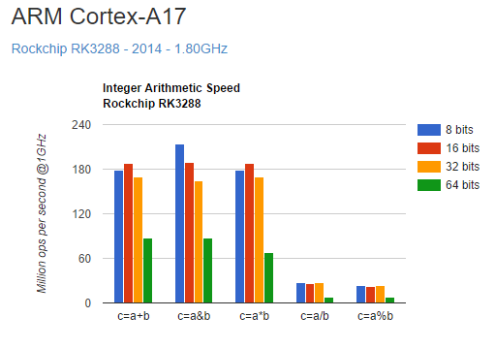
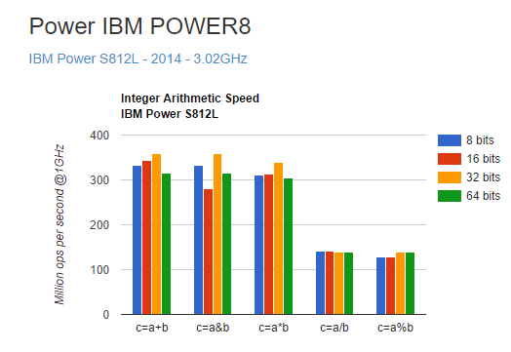
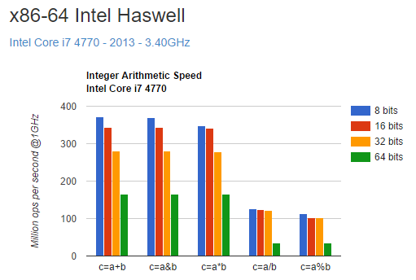
Cherry Picking Some Data
There’s lots wrong with the technique here, in part the
Author didn’t optimise their code properly… and got these results
Useful to know what happens when you do things wrong
(including use bad compiler options).
Notes:
http://nicolas.limare.net/pro/notes/2014/12/12_arit_speed/ - note the clocks aren’t the same so it’s not 1:1

Slide 6
Digital Logic
This course builds on digital logic (bottom up)*
But this course also builds on 1020 (top down)
* N.B. The reverse is sort of also true, in digital logic you learn to make things but without context have no idea how they’re useful

Slide 7
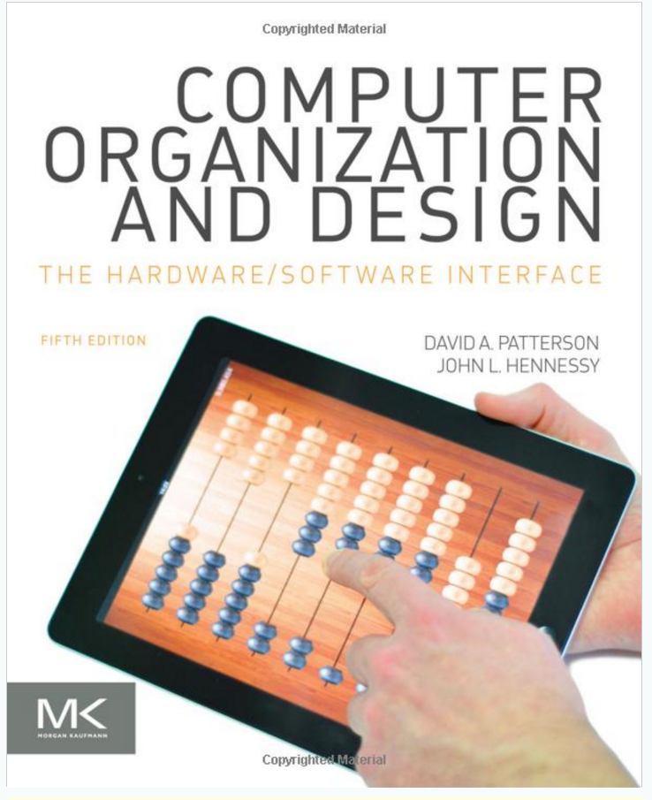
TextBook
Buy it
Yes really
Sorry
(And by buy, I mean the PDF version is fine)

Slide 8
Book
There are I think two versions of the same book
We want the MIPS version NOT the RISC-V version (I might adopt that in future but not this year, no time, not that it matters much)

Slide 9
Mars
The book comes with a program called Mars
(MIPS assembler and Runtime Simulator)
MIPS is a fake(sort of) assembly language, it’s pretty much the standard one people actually use for teaching
Unfortunately Mars runs on java. So you need to have java installed.
http://courses.missouristate.edu/KenVollmar/mars/download.htm
https://www.java.com/en/

Slide 10
Java
Java is horrible, I know, sorry.
Always install java updates, if it breaks Mars, well then we’ll find another plan.
DO NOT LEAVE UNPATCHED JAVA RUNNING ON YOUR MACHINE

Slide 11
4k vs 1080
Oh and Mars sucks at 4k unless you use Java 9
It works, it’s just that the menu’s and text are absurdly tiny.

Slide 12
Evaluations
Type of Assignment | Weighting | Due Date
Labs (10 of 12) | 10 | Weekly
Assignment 1 | 10 | Jan 24
Assignment 2 | 10 | Feb 14
Midterm Examination | 20 | Feb 25 in Class
Assignment 3 | 10 | March 17
Assignment 4 | 10 | April 6th
Final Examination | 30 | TBA
Note, these dates may get moved back a bit (not the mid term), because it might be tricky to do everything you need to on time for A1 and A2.
Labs are due one week after the lab

Slide 13
Academic Integrity
Academic Integrity: Academic dishonesty, which includes plagiarism and cheating, is an extremely serious academic offence and carries penalties varying from a 0 grade on an assignment to expulsion from the University. Definitions, penalties, and procedures for dealing with plagiarism and cheating are set out in Trent University’s Academic Integrity Policy. You have a responsibility to educate yourself – unfamiliarity with the policy is not an excuse. You are strongly encouraged to visit Trent’s Academic Integrity website to learn more: www.trentu.ca/academicintegrity.

Slide 14
Lateness (Officially)…
Lateness: 10% per business day (i.e. any time on Saturday, Sunday or Monday will all be the same one day 10% late). Assignments will not be accepted if they are more than one week late. Extensions are possible if there is an emergency, or through arrangement with the instructor in advance. Appropriate documentation supporting extensions is required (e.g. note from medical practitioner, SAS Office, or Counselling Centre). Due dates will be adjusted if there are technical problems with Blackboard or labs providing support for the course.

Slide 15
Religious Accommodation
Over the summer that needs to be arranged with the instructor
The regular term it’s about the 3rd week in class you need to inform the registrar.

Slide 16
Access to Instruction
Access to Instruction: It is Trent University's intent to create an inclusive learning environment. If a student has a disability and documentation from a regulated health care practitioner and feels that he/she may need accommodations to succeed in a course, the student should contact the Student Accessibility Services Office (SAS) at the respective campus as soon as possible.

Slide 17
Course Outline
Lecture Topic | Lab topic
Introduction | Intro To MIPS and MARS
Assembly Programming (introduction) | , mips instructions
Arithmetic for computers | first MIPS program that does anything
Logical Design of a Processor | Procedure calls, recursion
Memory Hierarchy (cache) | Arithmetic
Mid Term
Storage (RAM and Disk) | Compiling to ASM, x86 (just a little)
Multicore processors | Profiling, Tracing
Review
Notes:
LEARN BINARY DECIMAL CONVERSIONS

Slide 18
MIPS, x86
MIPS is a Reduced instruction set system. (Meaning there aren’t that many instructions)
We run in a simulated environment
X86 Assembler – well, Intel assembly, is run using MASM as part of visual studio or GCC – GCC just added a new option (by just I mean last week) that might make this easier, so we’ll look into that later.
Debugging actual x86 code is frustratingly difficult, even getting it up and running is frustratingly difficult. So we’ll save that for later

Slide 19
ARM
ARM shows up two places, mobile devices and their derivatives in the CPU business
And Raspberry Pi
Actually doing assembly programming on a pi is a nightmare if it ever works, so I don’t recommend you try.

Slide 20
Workshops/Labs
The plan (at the moment) is that for several of them we’ll do something like tutorials/programming labs
So lab this week we’ll do assembly programming IDE
During lab I’ll expect you to talk with your friends in class and so on.

Slide 21
Labs
You need a laptop. Or maybe not.
The ATOP lab is up and running

Slide 22
Chapter 1
Computer Abstractions and Technology

Slide 23
The Computer Revolution
§1.1 Introduction
Progress in computer technology
Underpinned by Moore’s Law
Makes novel applications feasible
Computers in automobiles
Cell phones
Human genome project
World Wide Web
Search Engines
Computers are pervasive

Slide 24
Classes of Computers
Personal computers
General purpose, variety of software
Subject to cost/performance tradeoff
Server computers
Network based
High capacity, performance, reliability
Range from small servers to building sized

Slide 25
Classes of Computers
Supercomputers
High-end scientific and engineering calculations
Highest capability but represent a small fraction of the overall computer market
Embedded computers
Hidden as components of systems
Stringent power/performance/cost constraints

Slide 26
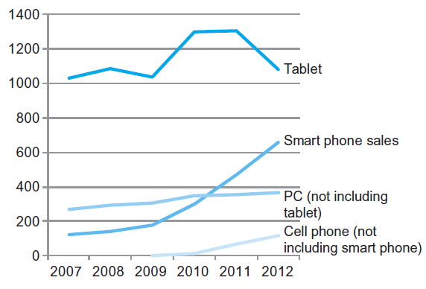
The PostPC Era

Slide 27
Tablet vs Slate
Note that the book uses the term “tablet” when it means “slate”
That has become the public convention because of the iPad, but more correctly it’s a slate.

Slide 28
The PostPC Era
Personal Mobile Device (PMD)
Battery operated
Connects to the Internet
Hundreds of dollars
Smart phones, tablets, electronic glasses
Cloud computing
Warehouse Scale Computers (WSC)
Software as a Service (SaaS)
Portion of software run on a PMD and a portion run in the Cloud
Amazon and Google

Slide 29
What You Will Learn
How programs are translated into the machine language
And how the hardware executes them
The hardware/software interface
What determines program performance
And how it can be improved
How hardware designers improve performance
What is parallel processing

Slide 30
Understanding Performance
Algorithm
Determines number of operations executed
Programming language, compiler, architecture
Determine number of machine instructions executed per operation
Processor and memory system
Determine how fast instructions are executed
I/O system (including OS)
Determines how fast I/O operations are executed

Slide 31








Eight Great Ideas
Design for Moore’s Law
Use abstraction to simplify design
Make the common case fast
Performance via parallelism
Performance via pipelining
Performance via prediction
Hierarchy of memories
Dependability via redundancy
§1.2 Eight Great Ideas in Computer Architecture

Slide 32
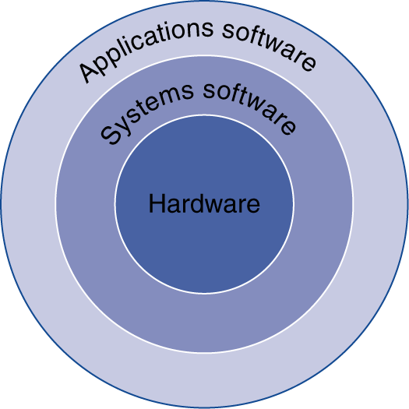
Below Your Program
Application software
Written in high-level language
System software
Compiler: translates HLL code to machine code
Operating System: service code
Handling input/output
Managing memory and storage
Scheduling tasks & sharing resources
Hardware
Processor, memory, I/O controllers
§1.3 Below Your Program

Slide 33
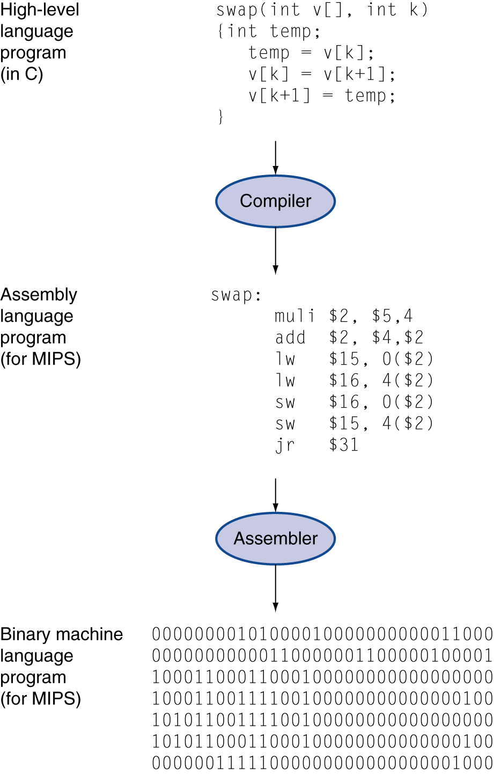
Levels of Program Code
High-level language
Level of abstraction closer to problem domain
Provides for productivity and portability
Assembly language
Textual representation of instructions
Hardware representation
Binary digits (bits)
Encoded instructions and data

Slide 34
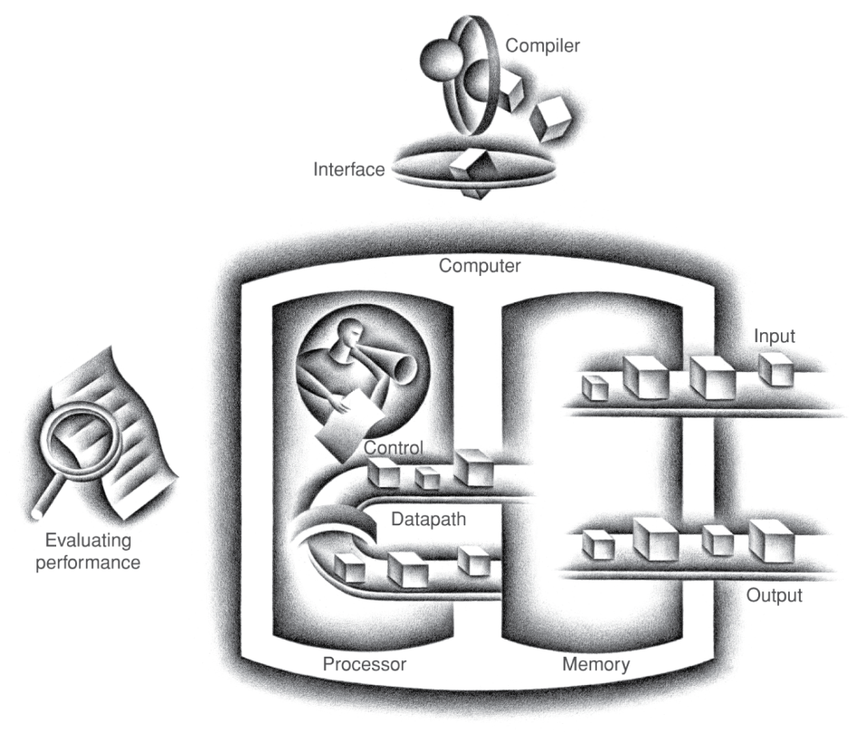
Components of a Computer
Same components for all kinds of computer
Desktop, server, embedded
Input/output includes
User-interface devices
Display, keyboard, mouse
Storage devices
Hard disk, CD/DVD, flash
Network adapters
For communicating with other computers
§1.4 Under the Covers
The BIG Picture

Slide 35
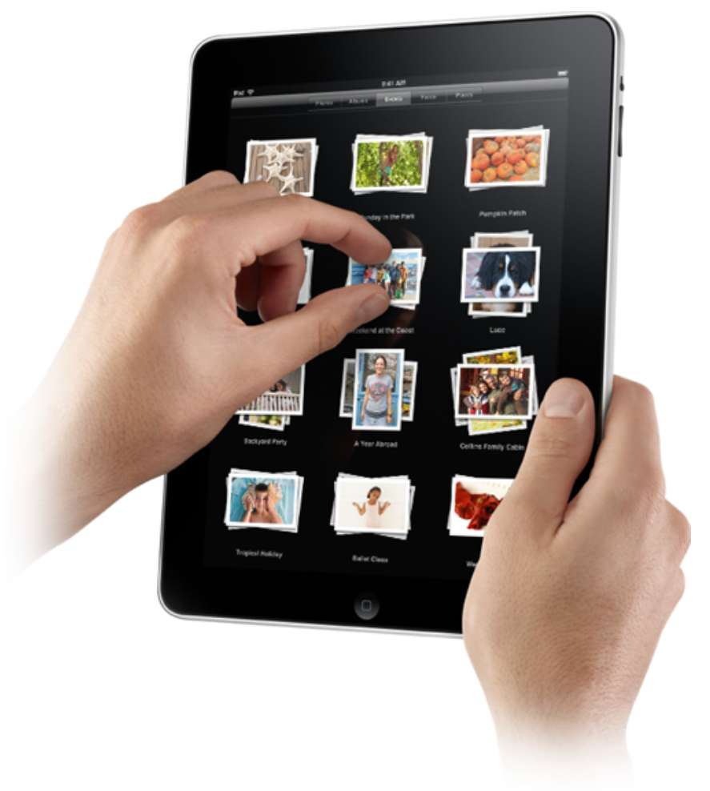
Touchscreen
PostPC device
Supersedes keyboard and mouse
Resistive and Capacitive types
Most tablets, smart phones use capacitive
Capacitive allows multiple touches simultaneously

Slide 36
https://www.youtube.com/watch?v=9BnLbv6QYcA

Slide 37
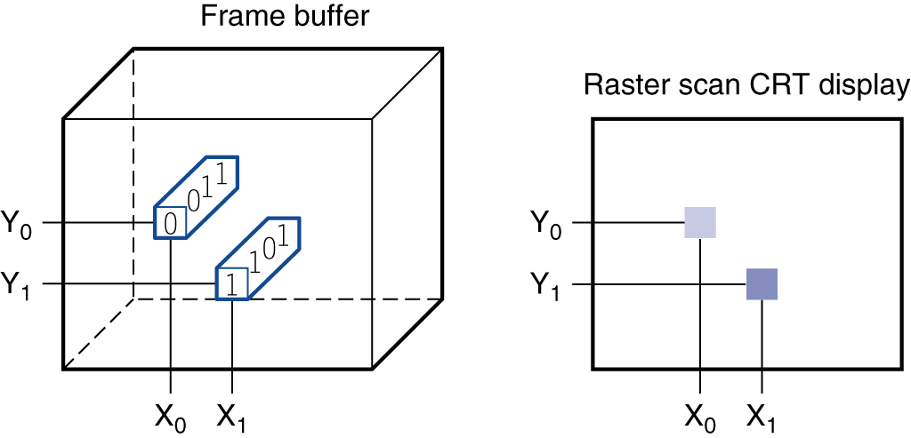
Through the Looking Glass
LCD screen: picture elements (pixels)
Mirrors content of frame buffer memory

Slide 38
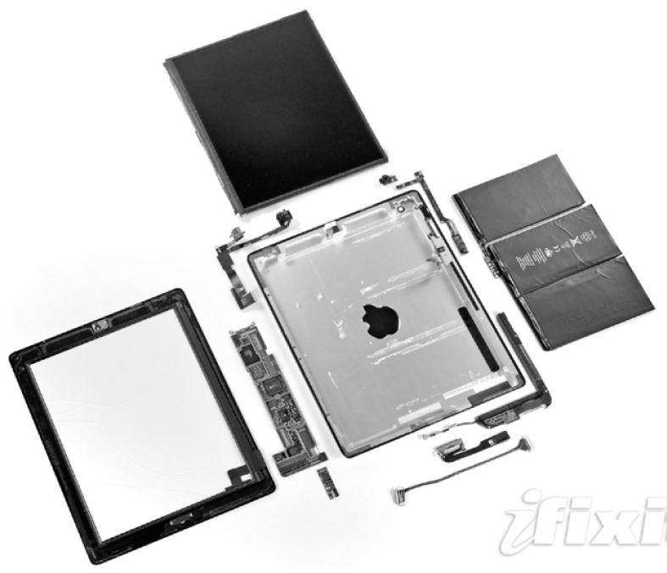
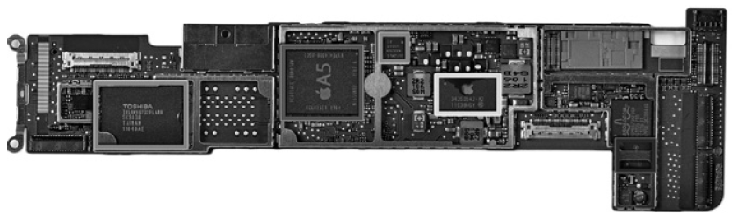
Opening the Box
Capacitive multitouch LCD screen
3.8 V, 25 Watt-hour battery
Computer board

Slide 39
Inside the Processor (CPU)
Datapath: performs operations on data
Control: sequences datapath, memory, ...
Cache memory
Small fast SRAM memory for immediate access to data

Slide 40
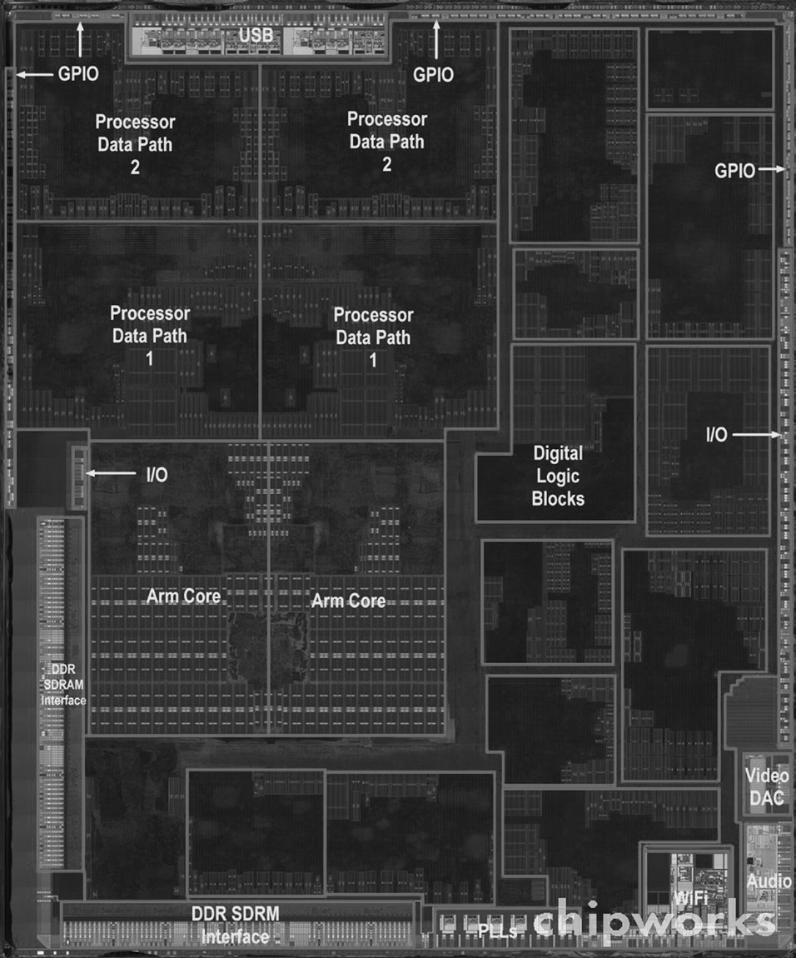
Inside the Processor
Apple A5
Notes:
GPIO means general purpose input output (USB or in the case of apple, thunderbolt connectors)
Data paths are a collection of parts that do something (Usually a computing task) along with memory and so on. In this case the A5 is a dual ARM cortex A9 cpu, and a dual core PowerVR SGX543MP2 GPU.

Slide 41
Abstractions
The BIG Picture
Abstraction helps us deal with complexity
Hide lower-level detail
Instruction set architecture (ISA)
The hardware/software interface
Application binary interface
The ISA plus system software interface
Implementation
The details underlying and interface

Slide 42
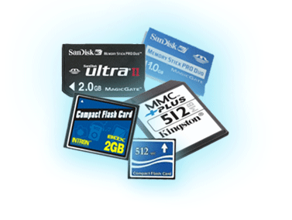
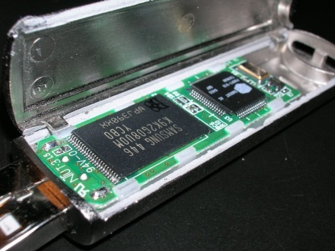
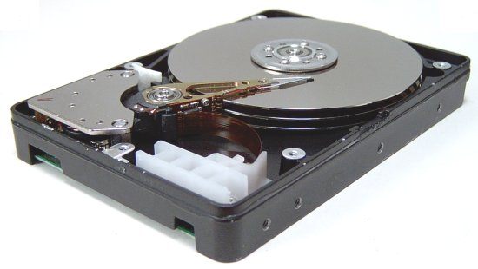
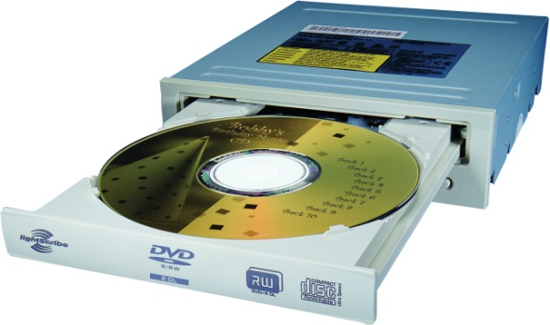
A Safe Place for Data
Volatile main memory
Loses instructions and data when power off
Non-volatile secondary memory
Magnetic disk
Flash memory
Optical disk (CDROM, DVD)

Slide 43
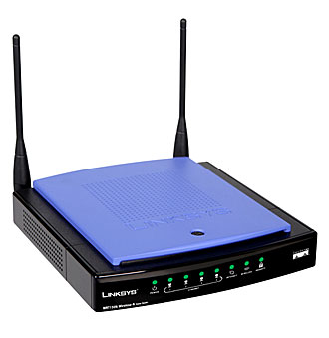
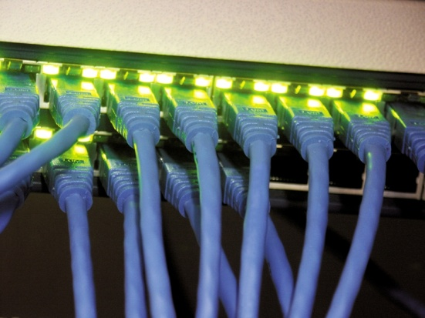
Networks
Communication, resource sharing, nonlocal access
Local area network (LAN): Ethernet
Wide area network (WAN): the Internet
Wireless network: WiFi, Bluetooth

Slide 44
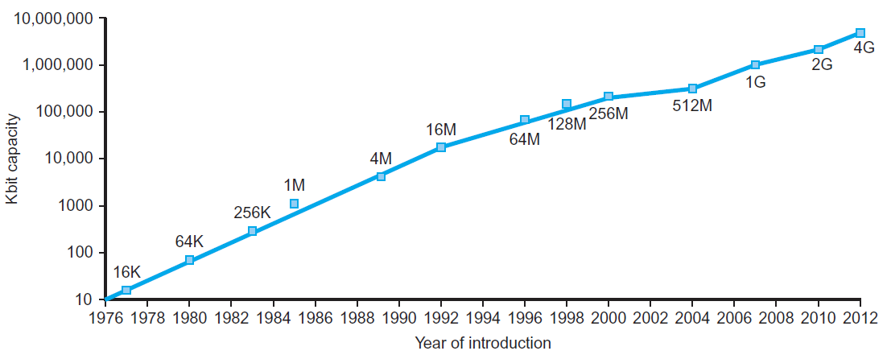
Technology Trends
Electronics technology continues to evolve
Increased capacity and performance
Reduced cost
§1.5 Technologies for Building Processors and Memory
DRAM capacity
Year | Technology | Relative performance/cost
1951 | Vacuum tube | 1
1965 | Transistor | 35
1975 | Integrated circuit (IC) | 900
1995 | Very large scale IC (VLSI) | 2,400,000
2013 | Ultra large scale IC | 250,000,000,000

Slide 45
Semiconductor Technology
Silicon: semiconductor
Add materials to transform properties:
Conductors
Insulators
Switch

Slide 46
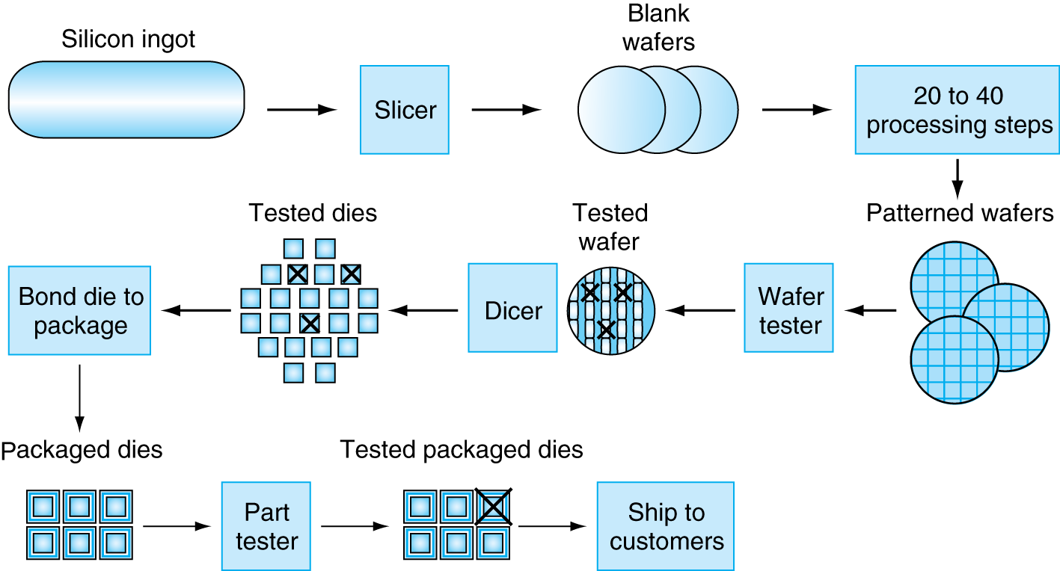
Manufacturing ICs
Yield: proportion of working dies per wafer

Slide 47
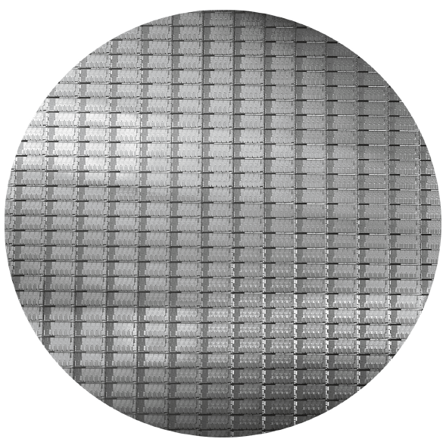
Intel Core i7 Wafer
300mm wafer, 280 chips, 32nm technology
Each chip is 20.7 x 10.5 mm

Slide 48
Integrated Circuit Cost
Nonlinear relation to area and defect rate
Wafer cost and area are fixed
Defect rate determined by manufacturing process
Die area determined by architecture and circuit design

Slide 49
Contracts
Intel (and sometimes Samsung) makes their own stuff
Everyone else buys from someone else (fabless, and fabs)
Some companies buy/sell wafers, others sell completed dies
Notes:
Sri note

Slide 50
Node Size
For want of a better way of putting it this usually measured in nm (today) or μm in the 1970’s
In ~2021 5nm will likely be the last (or close there to) semiconductor node using silicon
After that we might be able to use graphene down to 1nm
And then we’re boned
Notes:
Sri addition

Slide 51
Node Size Ctd
Think of a transistor has having it’s dimensions as being node size basically
So 5nm is twice the density of 7nm (roughly, 25nm² to 49nm²)
The problem is that at the current 14/16 nodes TSMC and Globalfoundries have started talking about the shortest side, not the average size, which is confusing
Notes:
Sri addition

Slide 52
Defining Performance
Which airplane has the best performance?
§1.6 Performance

Slide 53
Response Time and Throughput
Response time
How long it takes to do a task
Throughput
Total work done per unit time
e.g., tasks/transactions/… per hour
How are response time and throughput affected by
Replacing the processor with a faster version?
Adding more processors?
We’ll focus on response time for now…

Slide 54
Relative Performance
Define Performance = 1/Execution Time
“X is n time faster than Y”
Example: time taken to run a program
10s on A, 15s on B
Execution Time_{B} / Execution Time_{A} = 15s / 10s = 1.5
So A is 1.5 times faster than B

Slide 55
Measuring Execution Time
Elapsed time
Total response time, including all aspects
Processing, I/O, OS overhead, idle time
Determines system performance
CPU time
Time spent processing a given job
Discounts I/O time, other jobs’ shares
Comprises user CPU time and system CPU time
Different programs are affected differently by CPU and system performance

Slide 56
CPU Clocking
Operation of digital hardware governed by a constant-rate clock
Clock period
Clock (cycles)
Data transfer and computation
Update state
Clock period: duration of a clock cycle
e.g., 250ps = 0.25ns = 250×10^{–12}s
Clock frequency (rate): cycles per second
e.g., 4.0GHz = 4000MHz = 4.0×10⁹Hz

Slide 57
CPU Time
Performance improved by
Reducing number of clock cycles
Increasing clock rate
Hardware designer must often trade off clock rate against cycle count

Slide 58
CPU Time Example
Computer A: 2GHz clock, 10s CPU time
Designing Computer B
Aim for 6s CPU time
Can do faster clock, but causes 1.2 × clock cycles
How fast must Computer B clock be?

Slide 59
Instruction Count and CPI
Instruction Count for a program
Determined by program, ISA and compiler
Average cycles per instruction
Determined by CPU hardware
If different instructions have different CPI
Average CPI affected by instruction mix

Slide 60
CPI Example
Computer A: Cycle Time = 250ps, CPI = 2.0
Computer B: Cycle Time = 500ps, CPI = 1.2
Same ISA
Which is faster, and by how much?
A is faster…
…by this much

Slide 61
CPI in More Detail
If different instruction classes take different numbers of cycles
Weighted average CPI
Relative frequency

Slide 62
CPI Example
Alternative compiled code sequences using instructions in classes A, B, C
Class | A | B | C
CPI for class | 1 | 2 | 3
IC in sequence 1 | 2 | 1 | 2
IC in sequence 2 | 4 | 1 | 1
Sequence 1: IC = 5
Clock Cycles = 2×1 + 1×2 + 2×3 = 10
Avg. CPI = 10/5 = 2.0
Sequence 2: IC = 6
Clock Cycles = 4×1 + 1×2 + 1×3 = 9
Avg. CPI = 9/6 = 1.5

Slide 63
Performance Summary
The BIG Picture
Performance depends on
Algorithm: affects IC, possibly CPI
Programming language: affects IC, CPI
Compiler: affects IC, CPI
Instruction set architecture: affects IC, CPI, T_{c}

Slide 64
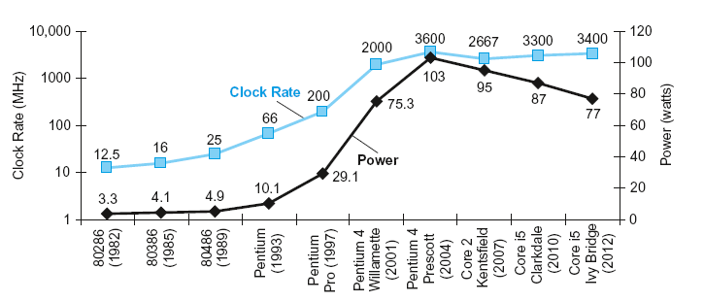
Power Trends
§1.7 The Power Wall
In CMOS IC technology
×30
5V → 1V
×1000

Slide 65
Reducing Power
Suppose a new CPU has
85% of capacitive load of old CPU
15% voltage and 15% frequency reduction
The power wall
We can’t reduce voltage further
We can’t remove more heat
How else can we improve performance?

Slide 66
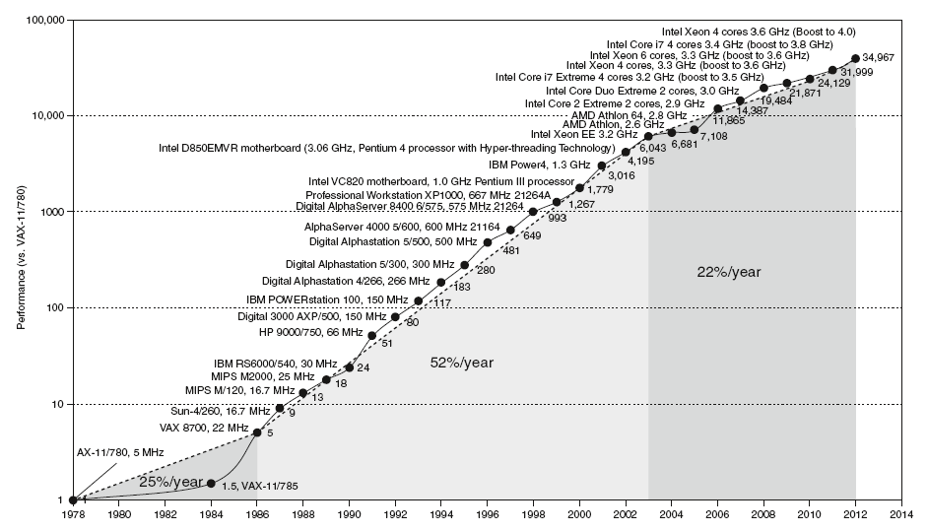
Uniprocessor Performance
§1.8 The Sea Change: The Switch to Multiprocessors
Constrained by power, instruction-level parallelism, memory latency

Slide 67
Multiprocessors
Multicore microprocessors
More than one processor per chip
Requires explicitly parallel programming
Compare with instruction level parallelism
Hardware executes multiple instructions at once
Hidden from the programmer
Hard to do
Programming for performance
Load balancing
Optimizing communication and synchronization

Slide 68
SPEC CPU Benchmark
Programs used to measure performance
Supposedly typical of actual workload
Standard Performance Evaluation Corp (SPEC)
Develops benchmarks for CPU, I/O, Web, …
SPEC CPU2006
Elapsed time to execute a selection of programs
Negligible I/O, so focuses on CPU performance
Normalize relative to reference machine
Summarize as geometric mean of performance ratios
CINT2006 (integer) and CFP2006 (floating-point)

Slide 69
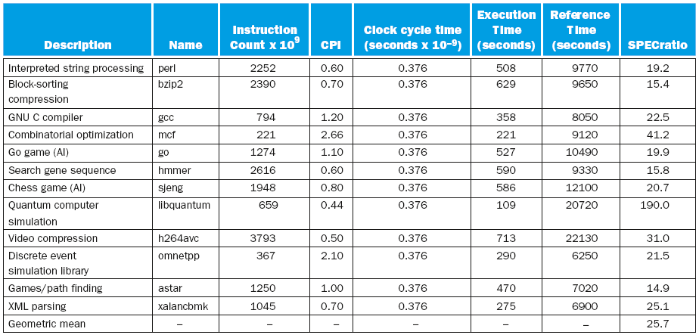
CINT2006 for Intel Core i7 920

Slide 70
SPEC Power Benchmark
Power consumption of server at different workload levels
Performance: ssj_ops/sec
Power: Watts (Joules/sec)

Slide 71
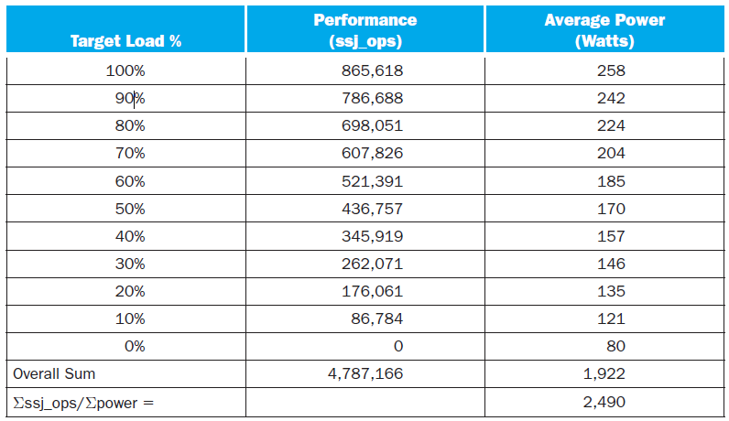
SPECpower_ssj2008 for Xeon X5650

Slide 72
SPEC
SPEC isn’t particularly well regarded in the CPU benchmarking community it is good for comparing different architectures to each other but otherwise is pretty bad

Slide 73
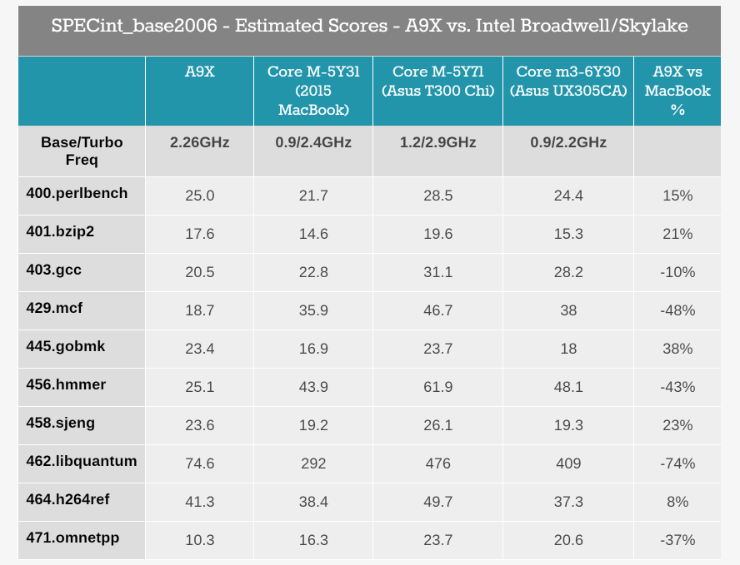
Apple A9 vs Intel
Notes:
http://www.anandtech.com/show/9766/the-apple-ipad-pro-review/4

Slide 74
The M 5Y71
The Core M 5Y71 is a 4.5 Watt processor
The A9 is about the same (3.5-4 as best I can tell)
These are a long way from the good CPU’s that can draw 200W and are easily a factor of 7 more powerful
(note that good CPU’s don’t integrate GPU’s which the M line and A9 do, so again, different products)
Notes:
http://ark.intel.com/products/84672/Intel-Core-M-5Y71-Processor-4M-Cache-up-to-2_90-GHz

Slide 75
Pitfall: Amdahl’s Law
Improving an aspect of a computer and expecting a proportional improvement in overall performance
§1.10 Fallacies and Pitfalls
Example: multiply accounts for 80s/100s
How much improvement in multiply performance to get 5× overall?
Can’t be done!
Corollary: make the common case fast

Slide 76
Fallacy: Low Power at Idle
Look back at i7 power benchmark
At 100% load: 258W
At 50% load: 170W (66%)
At 10% load: 121W (47%)
Google data center
Mostly operates at 10% – 50% load
At 100% load less than 1% of the time
Consider designing processors to make power proportional to load

Slide 77
Pitfall: MIPS as a Performance Metric
MIPS: Millions of Instructions Per Second
Doesn’t account for
Differences in ISAs between computers
Differences in complexity between instructions
CPI varies between programs on a given CPU

Slide 78
Concluding Remarks
Cost/performance is improving
Due to underlying technology development
Hierarchical layers of abstraction
In both hardware and software
Instruction set architecture
The hardware/software interface
Execution time: the best performance measure
Power is a limiting factor
Use parallelism to improve performance
§1.9 Concluding Remarks

